Slide 1
DEFECTS TRACKER - QUALITY CONTROL IN GARMENT INDUSTRY

Slide 2
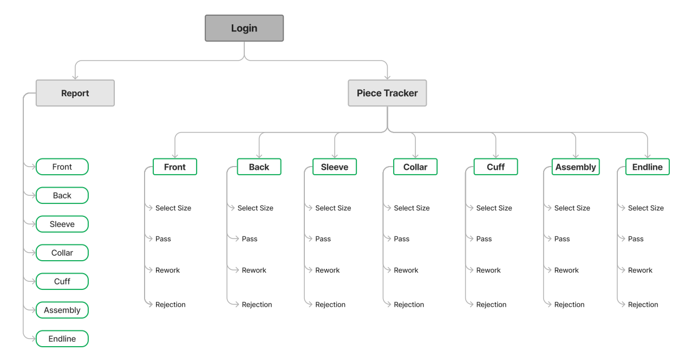

Slide 3
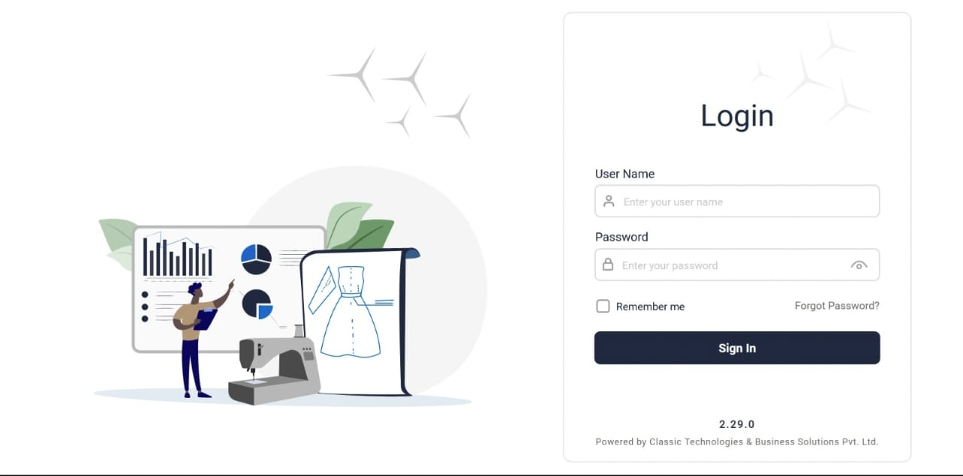

Slide 4
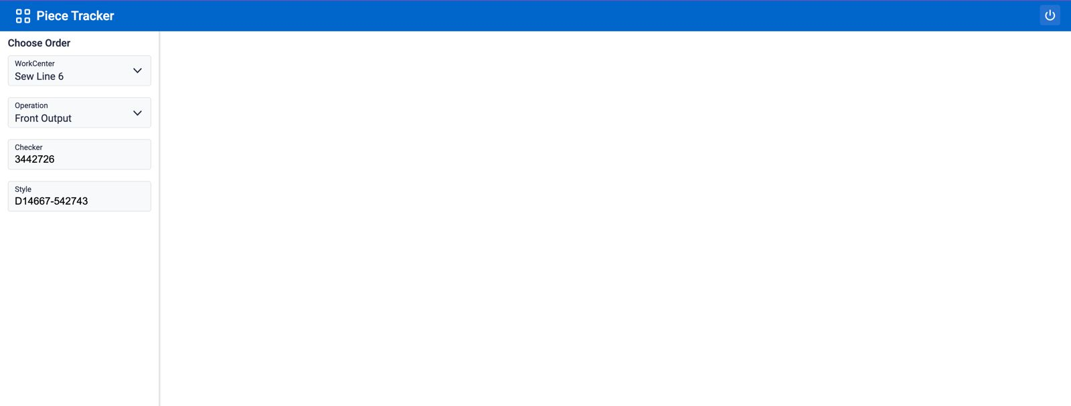
In work centre their will a drop down
Sewing line 1
Sewing line 2
Sewing line 3
Sewing line 4
Sewing line 5
Sewing line 6
In Operation their will a drop down
Front
Back
Sleeve
Cuff
Collar
Assembly
End line
Checker and Style are manual entry
After selecting all the options on the left side sizes will appear on the right side as shown in the next slide

Slide 5
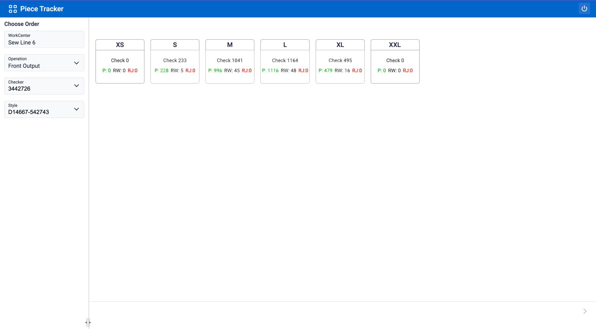
We will select the size

Slide 6
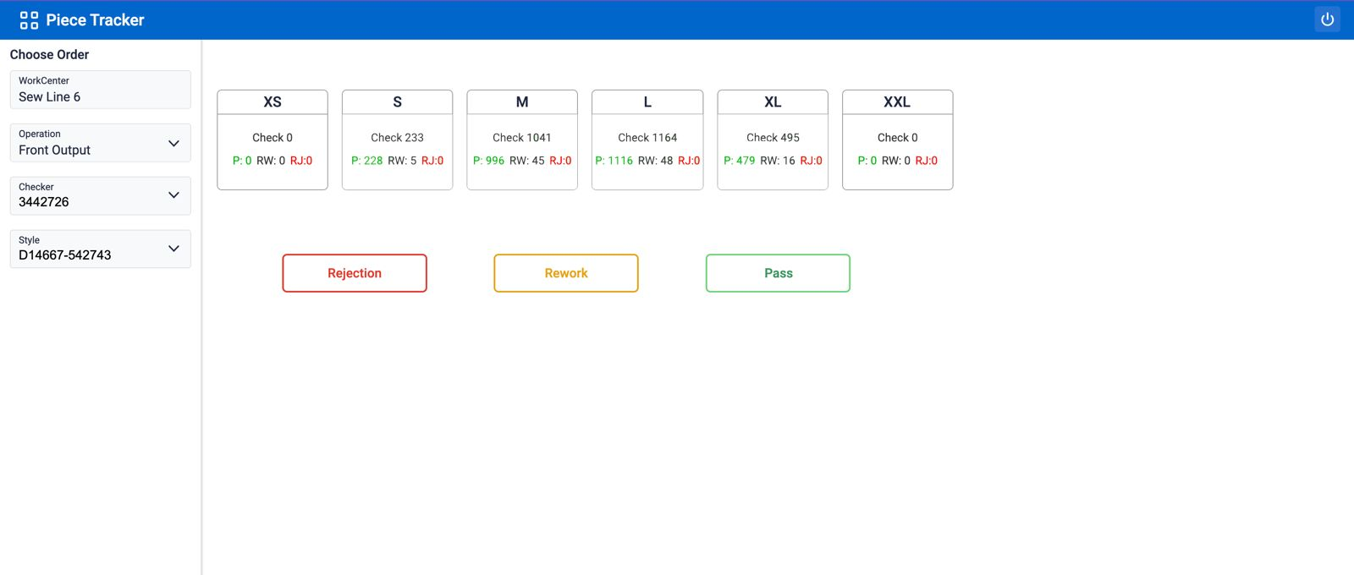
After selecting the size 3 options will appear
Pass
Rework
Rejection
When we select the rework and rejection we will get a new page where defects types are mentioned

Slide 7
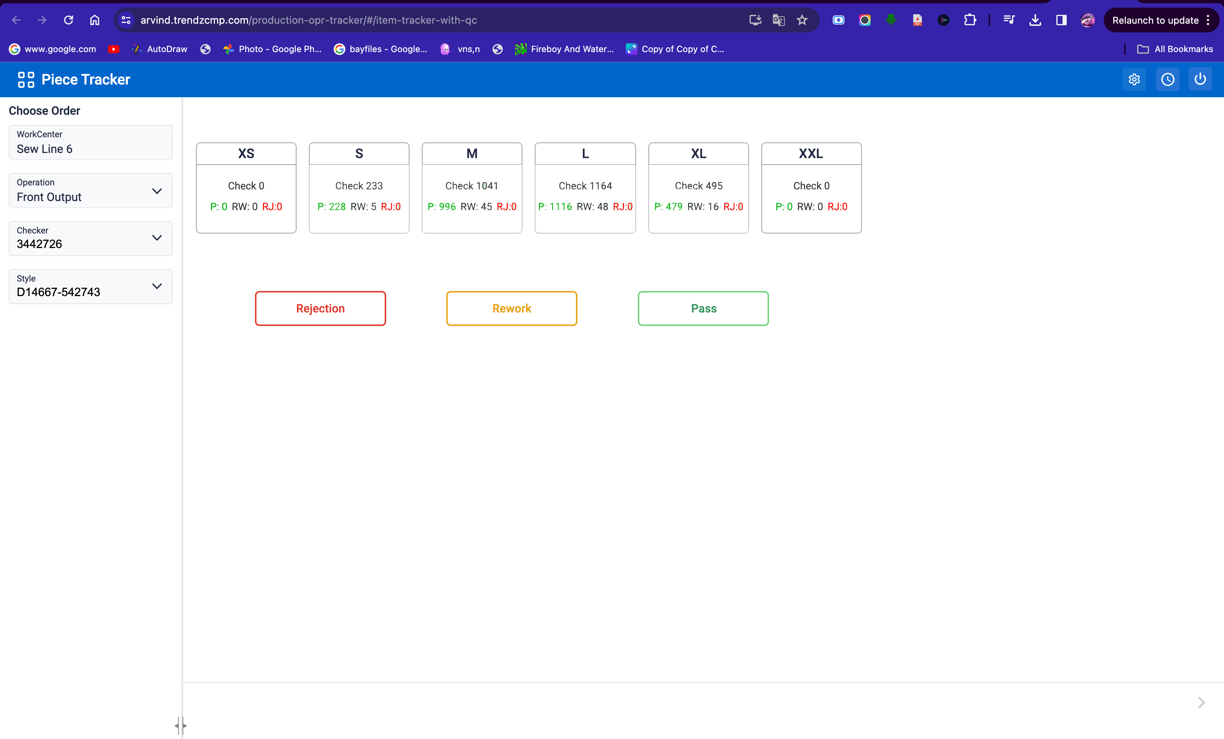
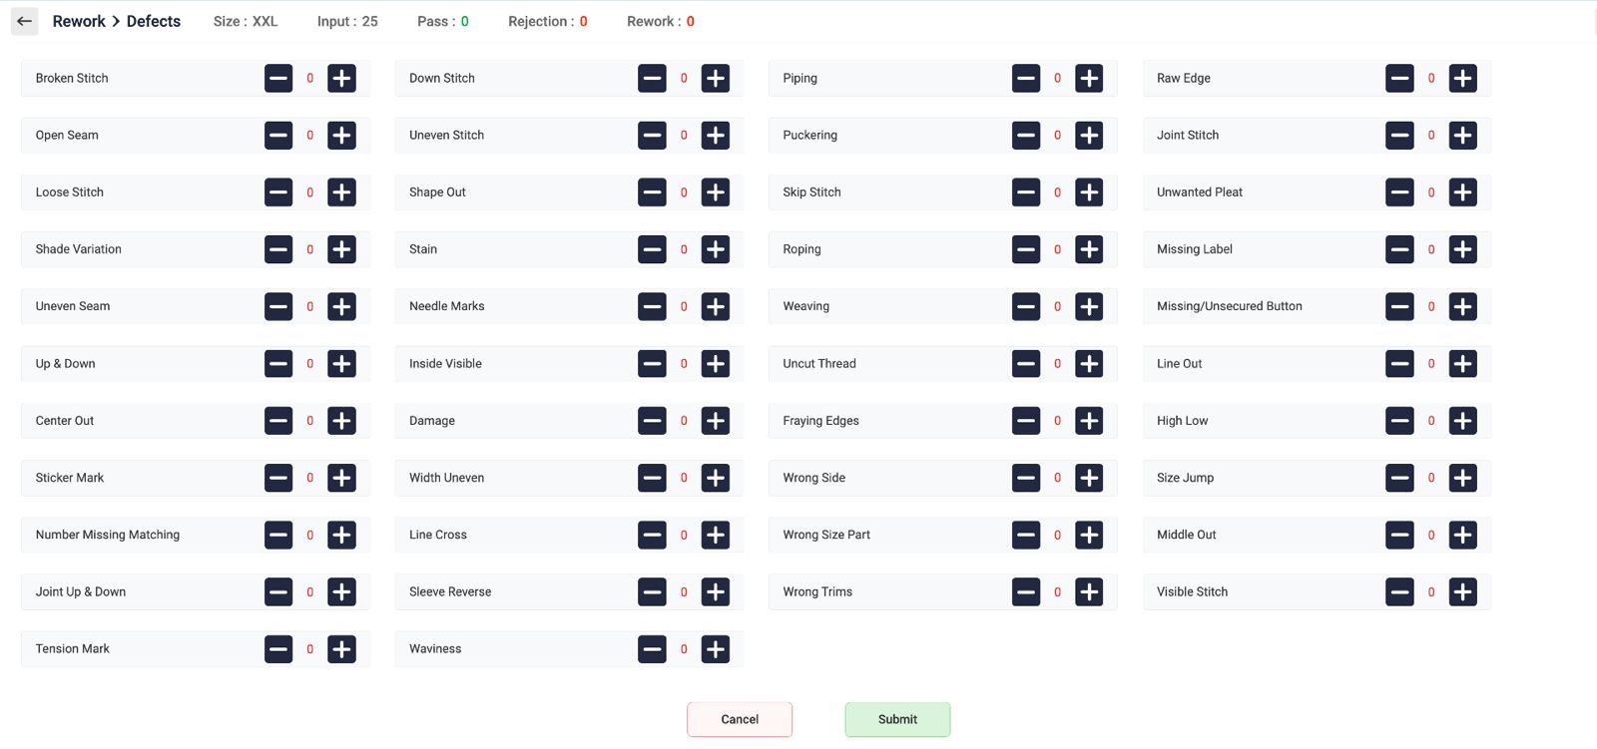
When we click on rework button this page will appear
Here we will selects the particular defect and the submit
It is same for all operations.

Slide 8
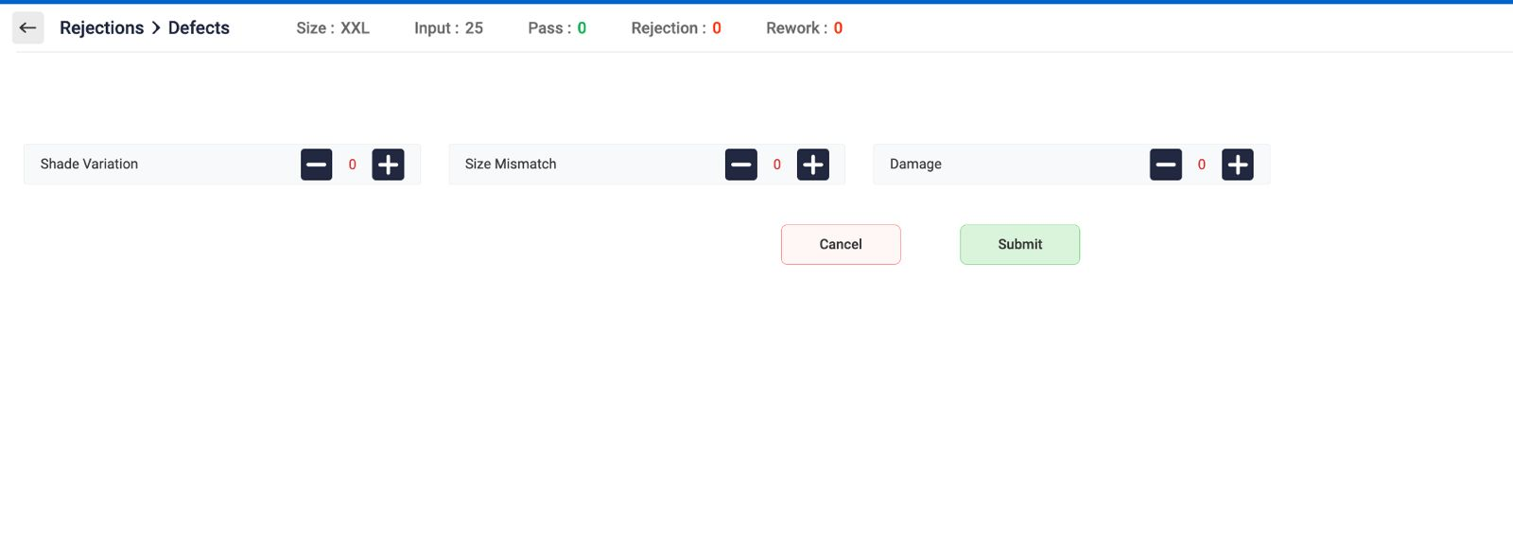
When we click on rejection button this page will appear
Here we will selects the particular defect and the submit
It is same for all operations.

Slide 9
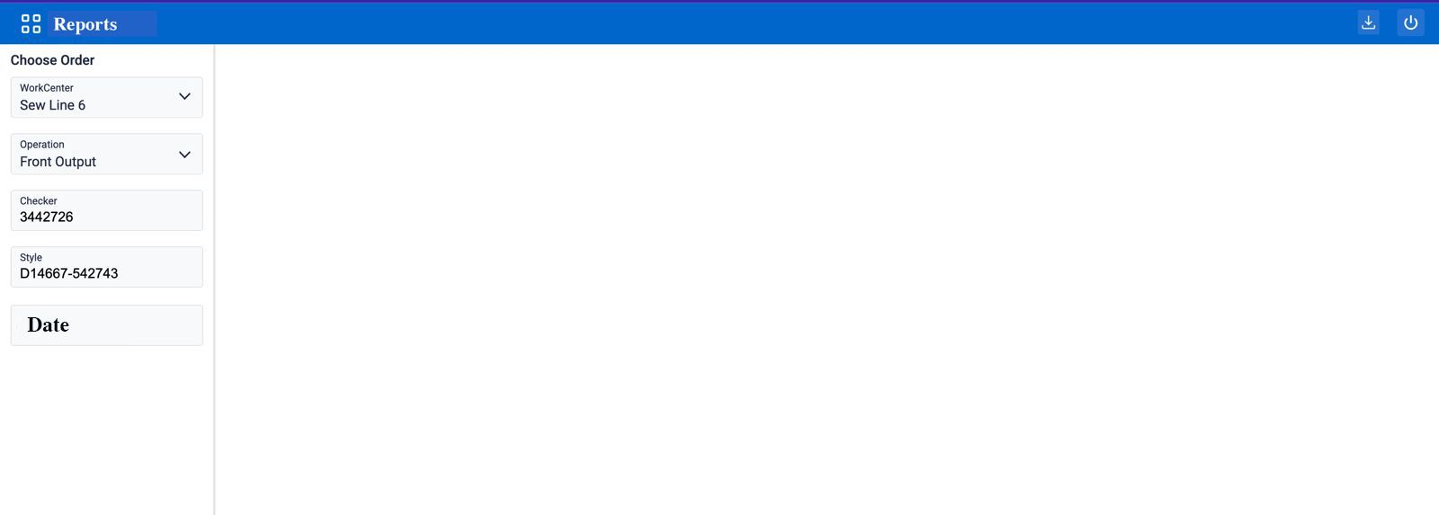
This is the reports page we have fill the left side options
Here checker is not mandatory to fill

Slide 10
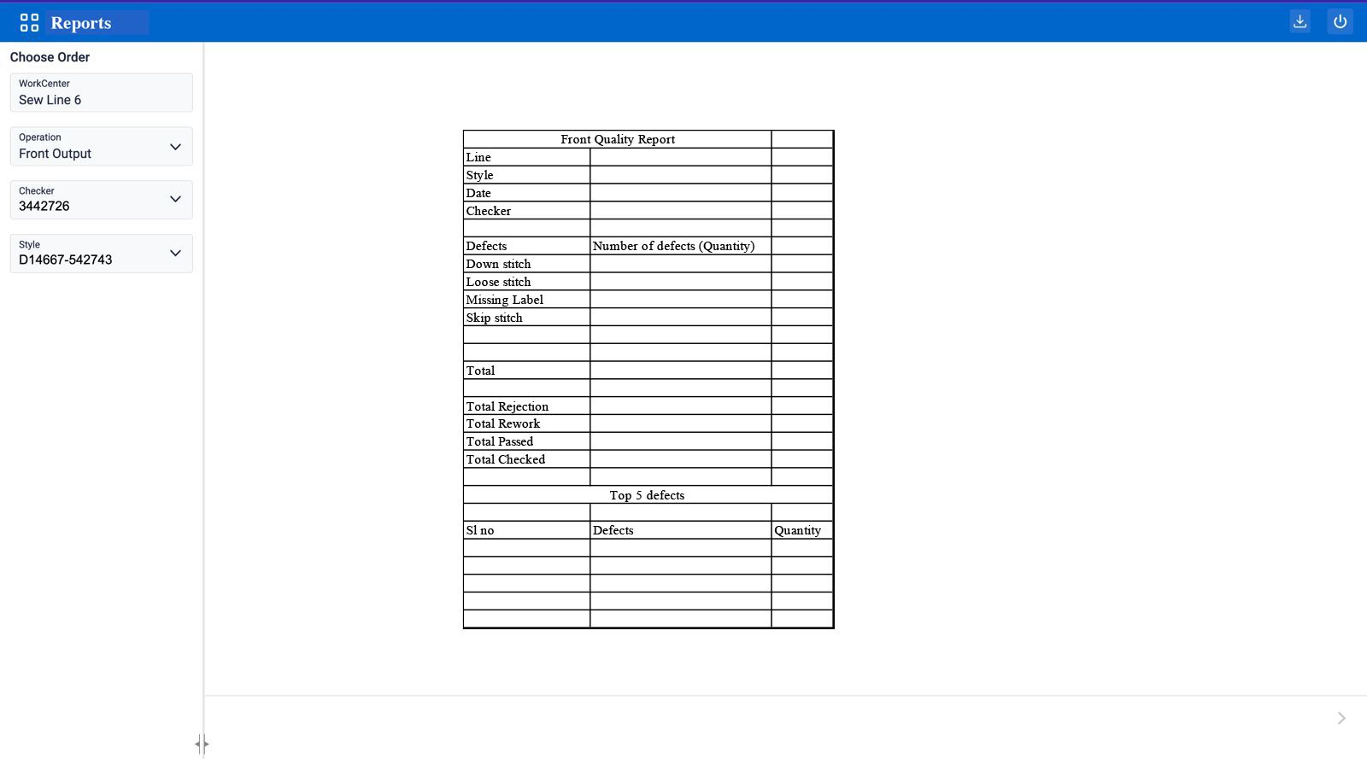
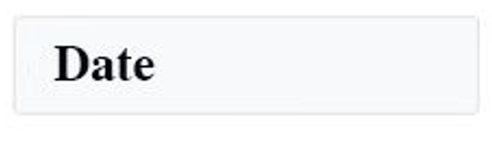
Then we have to get the report in this format in pdf which is able to download

